Slide 1

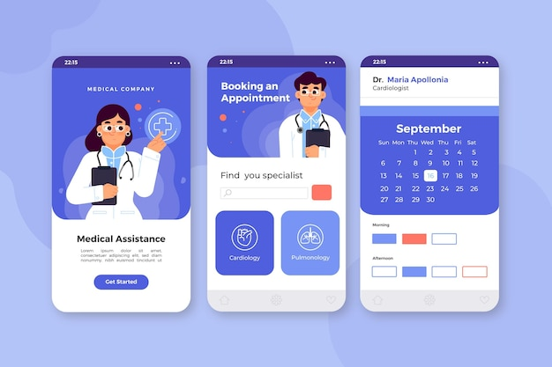
Online Hospital Appointment Booking System
Presented By
Sai Prathap Reddy .M
Venkata sainadh .S

Slide 2

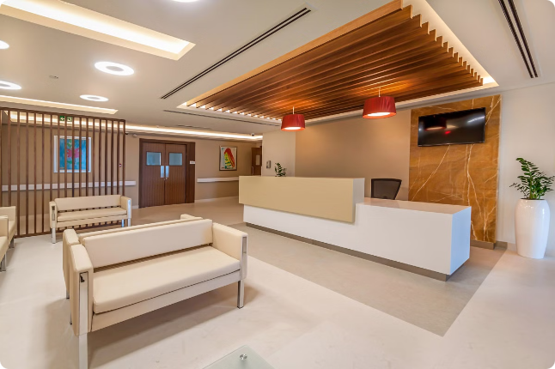
Online Hospital Appointment Booking System
This presentation outlines the creation of a website for an online hospital appointment booking system. The system aims to facilitate easy scheduling of medical appointments, enhancing patient experience and operational efficiency for healthcare providers.

Slide 3


Problem Statement
1
Time-Consuming Appointments
2
Limited Accessibility
Booking through calls can be inconvenient for many.
Patients often face long wait times for appointments.
3
Fragmented Systems
Existing solutions lack integration and user-friendliness.

Slide 4

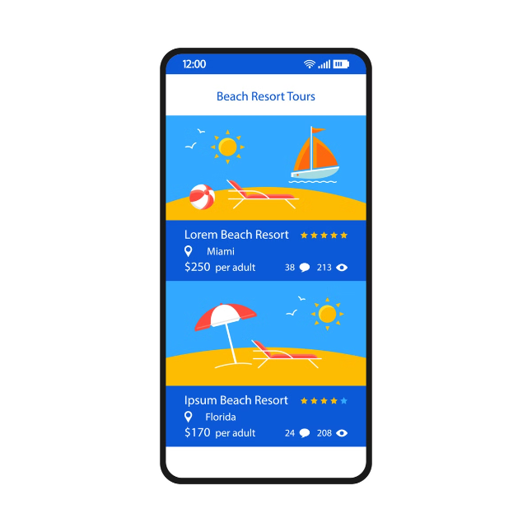
Abstract
The online appointment booking system aims to streamline the process. It offers users a seamless interface for scheduling appointments at their convenience, improving patient satisfaction while reducing administrative workload.

Slide 5
Existing System
Manual Booking
Limited Availability
High Administrative Load
Patients call to book appointments, leading to errors.
Doctors' schedules may not be updated in real-time.
Staff spends significant time managing bookings manually.

Slide 6

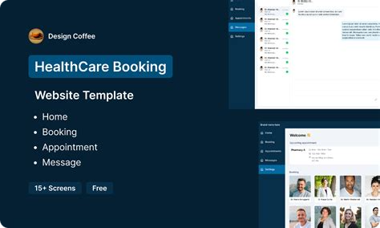
Proposed System
1
User Registration
Users create accounts for appointment management.
2
Appointment Scheduling
Patients can view available time slots and choose a doctor.
3
Reminders & Notifications
Automatic reminders reduce no-shows and increase accountability.

Slide 7

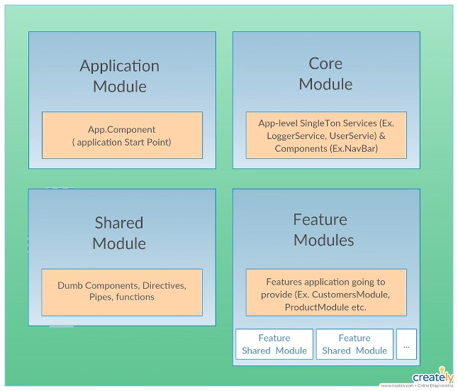
Modules Description
User Module
Appointment Module
Handles user registration and profile management.
Manages appointment bookings, updates, and cancellations.
Notification Module
Admin Module
Provides reminders via email or SMS.
Allows admin to manage users and appointments effectively.

Slide 8
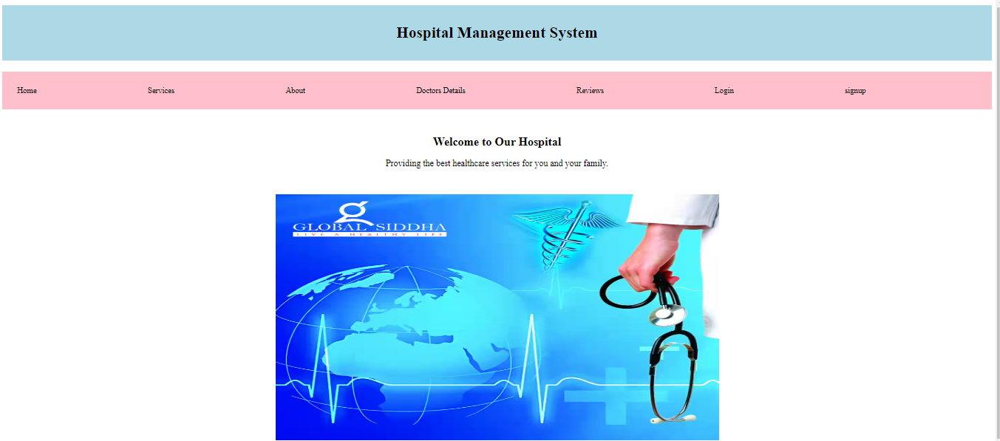
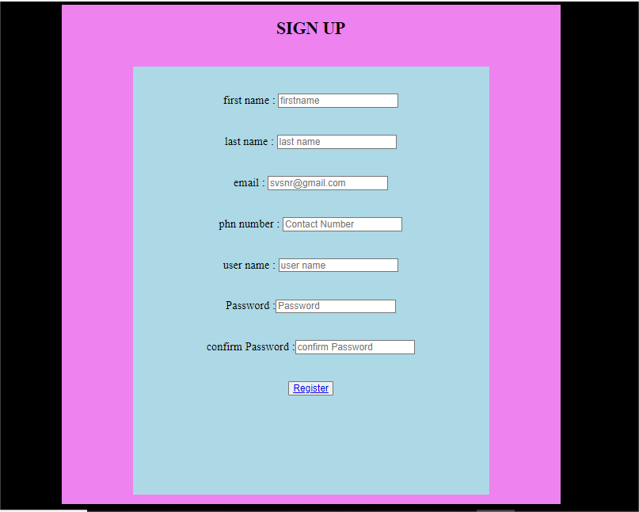
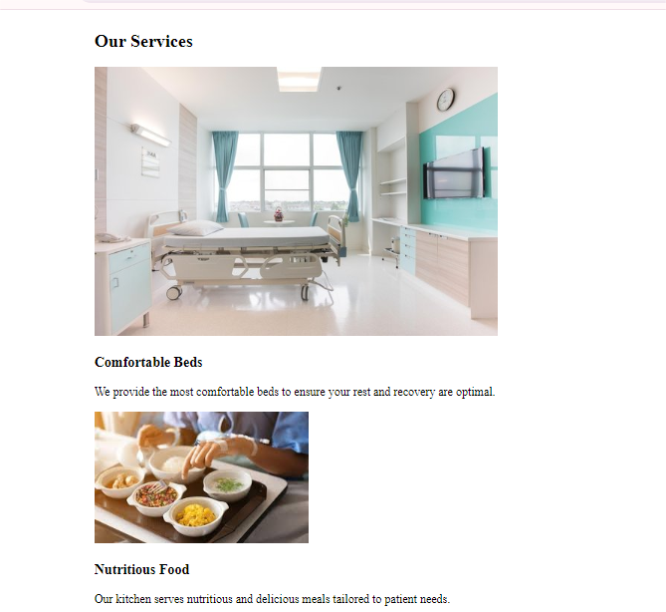
Screen Shots
Home page
Sign-up page
Services page

Slide 9
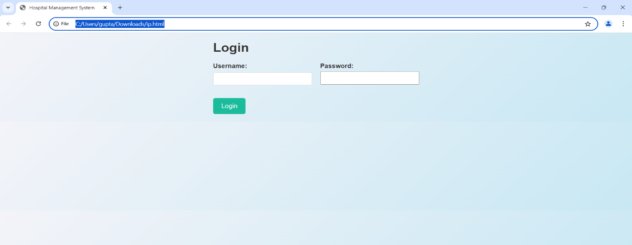
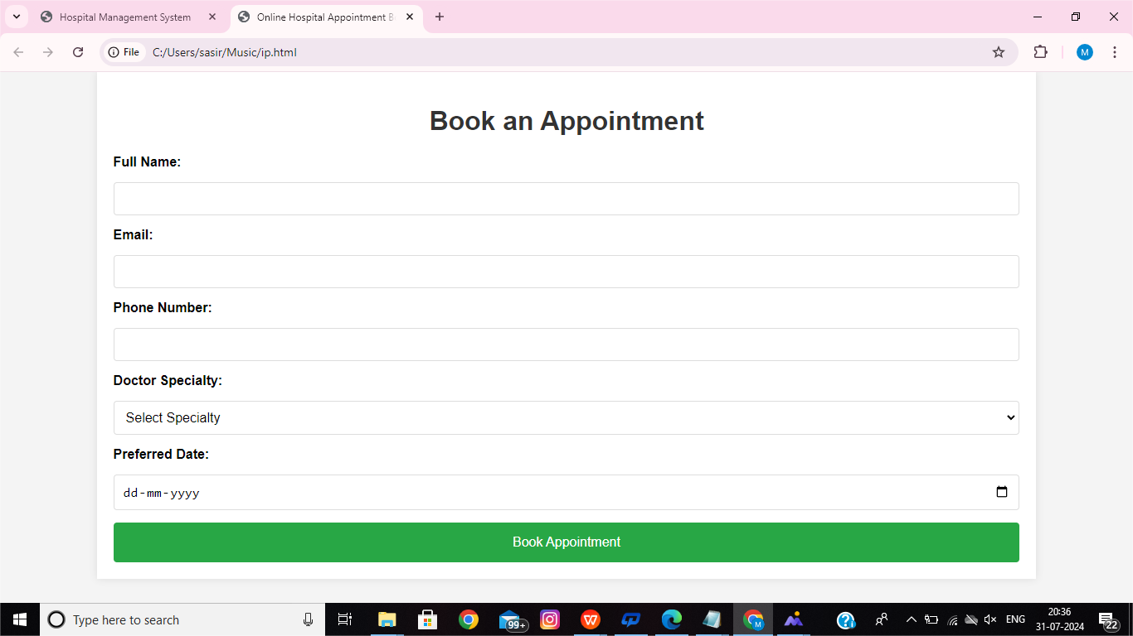
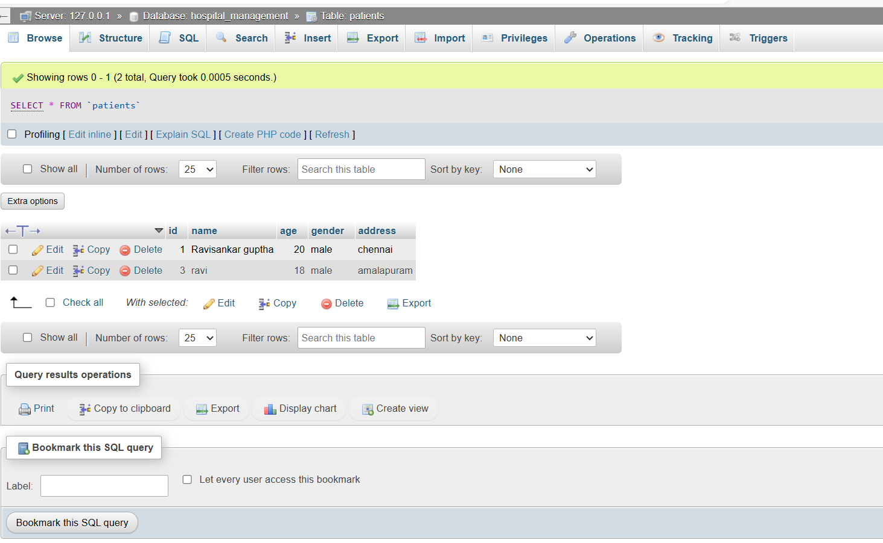
Login Page
Appointment Selection
Report Page
The initial entry point for users.
Users can choose their desired services and times.
Users can view and manage their appointments history.

Slide 10


Conclusion
1
Enhanced Convenience
2
Efficiency Improvement
Patients can book appointments anytime and anywhere.
Reduces administrative overhead and enhances service delivery.
3
Increased Patient Satisfaction
Simplifies the process, fostering better relationships.

Slide 11


Future Enhancements
1
Telemedicine Integration
2
AI-driven Recommendations
Facilitating virtual appointments for better access.
Providing personalized healthcare suggestions for users.
3
Mobile Application
Developing an app for easier booking on the go.

Slide 12

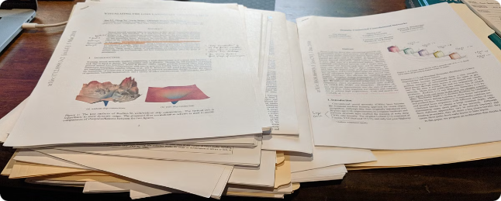
References
This section includes resources and literature used to develop the project. Key references consist of academic articles, healthcare IT reports, and industry standards relevant to appointment scheduling systems.
Full stack Vue: The Complete Guide to Vue.js by Hassan Djirdeh, Nate Murray, and Ari Lerner
Full-Stack React, TypeScript, and Node: Build Cloud-Ready Web Applications Using React 17 with Hooks and GraphQL by David Choi
Full-Stack Web Development with Node.js, Express, and MongoDB" by Colt Steele on Udemy.

Slide 13


